Slide 1

Project Scope Management
Group 1
Rola AlaaEldeen Abdelkareem
Soha Mohamed Ahmed Mahmoud
Aya Khaled Abdellah Abdallah

Slide 2
Meaning of the project in the project management:
A project is defined as a sequence of tasks that must be completed to attain a certain outcome. According to the Project Management Institute , the term Project refers to ” to any temporary endeavor with a definite beginning and end”. Depending on its complexity, it can be managed by a single person or hundreds
Project Scope Management:
Project scope management is a process that helps in determining and documenting the list of all the project goals, tasks, deliverables, deadlines, and budgets as a part of the planning process.
Importantance of the Project Scope Management:
For a project manager ,the most challenging tasks. With a definite project scope, managers can easily stay on track and ensure that all the deadlines are being followed throughout the project life cycle.

Slide 3

A well-defined project scope management helps avoid common issues like:
Constantly changing requirements
Pivoting the project direction when
you are already mid-way
Realizing that the final outcome
Establishes a smooth workflow
isn’t what was expected
Going over the discussed budget
Falling behind the project
deadlines
Effective project scope management gives a clear idea about the time, labor, and cost involved in the project. It helps to distinguish between what is needed and what isn’t needed for accomplishing the project. Scope in project management also establishes the control factors of the project to address elements that might change during the project life cycle.
Establish a smooth work flow

Slide 4
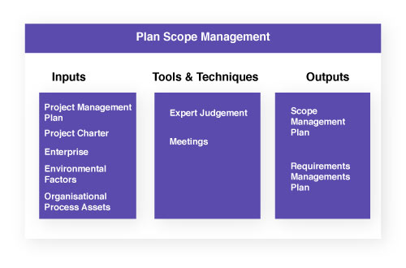
You can also define it as a process that simplifies your scope documentation process. It simply streamlines the workflow and maintains the focus on the scope.
Steps Involved in Project Scope Management:
Plan scope management:
Undoubtedly there are various ways to
create a scope document. In this phase,
the project manager defines the
scope to suit the organization’s
standards. The scope
management plan reduces
future risks to the scope. It identifies areas that might cause serious damage to the scope and rectifies it. This is the initial step that says how you will maintain the scope throughout the project.

Slide 5
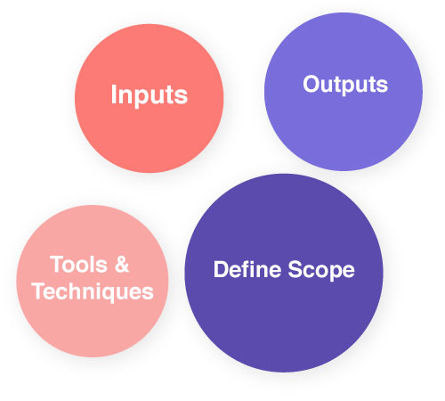
2. Collect requirements:
In an organization, there are a lot of parties involved who make the decision. It is not just between the manager and the client. The project manager must collect the requirements from all the authorities involved. You can also start making prototypes to see whether it fits the client’s requirements.
3. Define scope:
After making these plans,
you must start scrutinizing each step.
You must make sure that all the steps
carried out favor the scope. In this phase,
you will draft your final project
scope statement. It must contain all the
elements mentioned earlier in this blog. You also include a list of processes that are unnecessary
for the project. It is an important document that avoids future confusion in the project. As a scope of project example, consider an aircraft manufacturing unit. The client specifies that the aircraft must have a heat-resistant coating. But it is a necessity to mention to avoid certain heat-resistant coating procedures. This is where the scope document becomes useful. The employee can easily look at the scope statement and find the excluded processes list.

Slide 6
4. Create a Work Breakdown Structure:
By referring to the plan and scope document, it is time to create a WBS. Work breakdown structure enables the project manager to break the project into smaller tasks. It is a part of scope management because even the small tasks must remain inside the project’s scope. WBS prevents the straying of small tasks. It also prevents the isolation of tasks. Establishing WBS is a critical step in keeping the team engaged on the right path.

Slide 7
5. Validate scope:
Until now, the project scope has been nothing more than a draft. To become an official document, you have to get it approved by the respective authorities. The draft may receive change requests from either the client or the stakeholder. Only after it gets the final approval, it transforms into a proper scope document that your employees can refer to.
6. Control scope:
This is an important part of project scope management. The primary aim is to keep the project within the scope. It is exactly what the control phase strives to achieve. By laying out guidelines to monitor the project, it effectively manages to keep the project within its scope.
Sometimes you may need to change the scope or alter it according to customer requests. By creating detailed reports, you must see whether the new scope fits your business goals. Thus, constantly filling any gaps in the efficiency of the project.
Good scope management improves communication between the organization and the client. You can retain clients for future projects by delivering successful projects. Client satisfaction increases when the project is just what they expected.

